Slide 1



Hygiene measures and concepts to prevent COVID-19 infections in textile production facilities
GIZ training materials for online seminars
October 12, 2020

Slide 2
Contents
Objectives
Know your enemy
Transmission routes
COVID-19 mythbusters
Risk groups
Avoid getting sick
General information
Face masks
On the way to your workplace
At your workplace
Getting your workplace ready for COVID-19
For management level
For management level and personnel involved in cleaning
Facilitator’s tasks
Resources and guidance
p. 2 | October 12, 2020 | Hygiene measures and concepts to prevent COVID-19 infections in textile production facilities

Slide 3
COVID-19:
Facts, myths and proper behaviour
Overview of transmission routes, symptoms and methods to prevent infection.

Slide 4


Objective
Information on COVID-19 and possible transmission routes.
Hygiene training for employees.
Recommendations for the management level to get the workplace ready for COVID-19.
Hygiene concept for the workplace – for management and personnel involved in cleaning.
p. 4 | October 12, 2020 | Hygiene measures and concepts to prevent COVID-19 infections in textile production facilities

Slide 5

Know your
enemy
COVID-19
Infectious disease caused by the newly discovered coronavirus SARS-CoV-2.
Symptoms include fever, cough and shortness of breath. Symptoms can also include headache, body ache and a sore throat.
The incubation period of COVID-19, which is the time between exposure to the virus and symptom onset, is on average 5 to 6 days, but can be as long as 14 days.
p. 5 | October 12, 2020 | Hygiene measures and concepts to prevent COVID-19 infections in textile production facilities

Slide 6

Transmission
routes
COVID-19
The virus spreads mainly from person to person through direct contact, indirect contact (through contaminated objects or surfaces) or close contact with infected people via mouth and nose secretions.
For example, when an infected person coughs, sneezes, speaks or sings.
People who are in close contact (within 1 metre) to an infected person can catch COVID-19 when those infectious droplets get into their mouth, nose or eyes.
p. 6 | October 12, 2020 | Hygiene measures and concepts to prevent COVID-19 infections in textile production facilities

Slide 7

Transmission
routes
COVID-19
COVID-19 is primarily transmitted after people start showing symptoms. However, people can also be infectious before developing symptoms.
Someone who never develops symptoms can also pass the virus to others, but more research is needed in this area.
p. 7 | October 12, 2020 | Hygiene measures and concepts to prevent COVID-19 infections in textile production facilities

Slide 8


COVID-19 mythbusters
Facts
So far, there is no vaccine or cure for COVID-19.
COVID-19 can be transmitted in areas with hot and humid environments as well as in cold environments.
COVID-19 is caused by a virus, not by bacteria. Therefore, antibiotics do not work against COVID-19.
p. 8 | October 12, 2020 | Hygiene measures and concepts to prevent COVID-19 infections in textile production facilities

Slide 9

Risk
groups
COVID-19
All age groups can be infected.
Around 1 in 5 people who have COVID-19 need hospital treatment.
Older people and those with underlying medical problems like
cardiovascular disease,
diabetes,
chronic respiratory disease and
cancer
are more likely to develop serious illness.
p. 9 | October 12, 2020 | Hygiene measures and concepts to prevent COVID-19 infections in textile production facilities

Slide 10
Quizz 1
Can COVID-19 spread in warm sunny weather?
Yes
No
Don’t know
p. 10 | October 12, 2020 | Hygiene measures and concepts to prevent COVID-19 infections in textile production facilities

Slide 11
Quizz 1
Answer
Can COVID-19 spread in warm sunny weather?
Yes
No
Don’t know
Yes, COVID-19 also spreads in sunny and warm weather.
Getting out into the sunshine, if you can, is still a good idea as this helps your body produce vitamin D, which is important for your immune system.
p. 11 | October 12, 2020 | Hygiene measures and concepts to prevent COVID-19 infections in textile production facilities

Slide 12
Quizz 2
Can Chloroquine cure COVID-19?
Yes
No
Don’t know
p. 12 | October 12, 2020 | Hygiene measures and concepts to prevent COVID-19 infections in textile production facilities

Slide 13
Quizz 2
Answer
Can Chloroquine cure COVID-19?
Yes
No
Don’t know
No, at the moment, there is no proven cure for COVID-19.
Scientists and doctors continue their work to understand and treat COVID-19. For now, it is important to follow official government advice and get information only from reliable sources like the World Health Organization (WHO) or your government’s health department.
p. 13 | October 12, 2020 | Hygiene measures and concepts to prevent COVID-19 infections in textile production facilities

Slide 14

Avoid
getting sick
Generally…
Cover coughs and sneezes.
Wash your hands frequently with soap and water for at least 20s.
Use an alcohol-based hand sanitiser (>70% Alcohol) if water and soap are not available.
Avoid touching your eyes, nose and mouth with your unwashed hands.
p. 14 | October 12, 2020 | Hygiene measures and concepts to prevent COVID-19 infections in textile production facilities

Slide 15
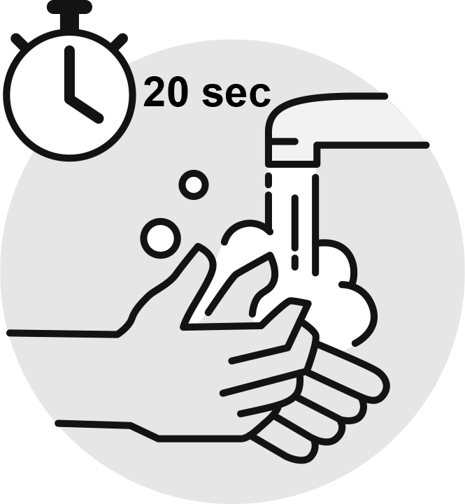

Avoid
getting sick
Best practice examples…
Sing 'happy birthday to you' in a moderate tempo twice in a row. This should take about 20s - a reasonable time for a proper hand wash.
Avoid the 3Cs: spaces that are closed, crowded or involve close contact.
The following link leads to a video on the WHO’s recommended method for washing hands: https://www.youtube.com/watch?v=IisgnbMfKvI
p. 15 | October 12, 2020 | Hygiene measures and concepts to prevent COVID-19 infections in textile production facilities

Slide 16
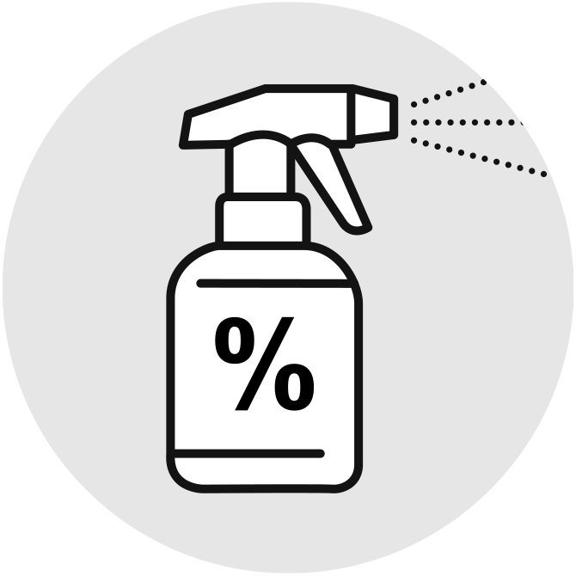
Avoid
getting sick
Generally…
Stay at least 1 metre* away from others.
Wear a mask when physical distancing (distance of at least 1 metre) is not possible.
Clean and disinfect frequently touched objects and surfaces.
*Physical distancing: As specified by the local government authorities or as specified by WHO (at least one metre).
p. 16 | October 12, 2020 | Hygiene measures and concepts to prevent COVID-19 infections in textile production facilities

Slide 17
Quizz 3
Please match the following terms and definitions.
Disinfecting
Removes germs in form of dirt, dust, visible debris and food particles.
Can destroy bacteria, virus and fungi (except their spores).
Cleaning
Reduces microbiological contamination on a clean surface.
Sanitising
p. 17 | October 12, 2020 | Hygiene measures and concepts to prevent COVID-19 infections in textile production facilities

Slide 18
Quizz 3
Answer
Please match the following terms and definitions.
Cleaning
Sanitising
Disinfecting
Removes germs in form of dirt, dust, visible debris and food particles.
Reduces microbiological contamination on a clean surface.
Can destroy bacteria, virus and fungi (except their spores).
p. 18 | October 12, 2020 | Hygiene measures and concepts to prevent COVID-19 infections in textile production facilities

Slide 19
Quizz 4
Please match the following terms and definitions.
Isolation
Separating people who are ill with symptoms of COVID-19.
Separating people who are not ill themselves but may have been exposed to COVID-19.
Distancing
General measure that everyone should take even if they are well with no known exposure to COVID-19.
Quaratine
p. 19 | October 12, 2020 | Hygiene measures and concepts to prevent COVID-19 infections in textile production facilities

Slide 20
Quizz 4
Answer
Please match the following terms and definitions.
Quarantine
Isolation
Distancing
Separating people who are not ill themselves but may have been exposed to COVID-19.
Separating people who are ill with symptoms of COVID-19.
General measure that everyone should take even if they are well with no known exposure to COVID-19.
p. 20 | October 12, 2020 | Hygiene measures and concepts to prevent COVID-19 infections in textile production facilities

Slide 21
Avoid
getting
sick
Procedures to avoid infection.

Slide 22
Avoid
getting sick
Face masks
Face masks should fit properly, completely covering the face from the bridge of the nose to the chin.
Clean hands properly before putting the face mask on or taking it off.
If the mask is re-usable, wash the face mask as soon as possible after use with detergent at 60°C.
Do not re-use single-use masks. Replace the mask with a new one as soon as it is damp.
p. 22 | October 12, 2020 | Hygiene measures and concepts to prevent COVID-19 infections in textile production facilities

Slide 23


Avoid
getting sick
On the way to your workplace
Avoid crowded places and public transport.
If possible, go by bike or walk.
If you have to use public transport, avoid touching surfaces (handrails, handholds in buses etc.) and wear a mask.
After commuting to and from work and throughout the day, wash your hands frequently and thoroughly.
p. 23 | October 12, 2020 | Hygiene measures and concepts to prevent COVID-19 infections in textile production facilities

Slide 24

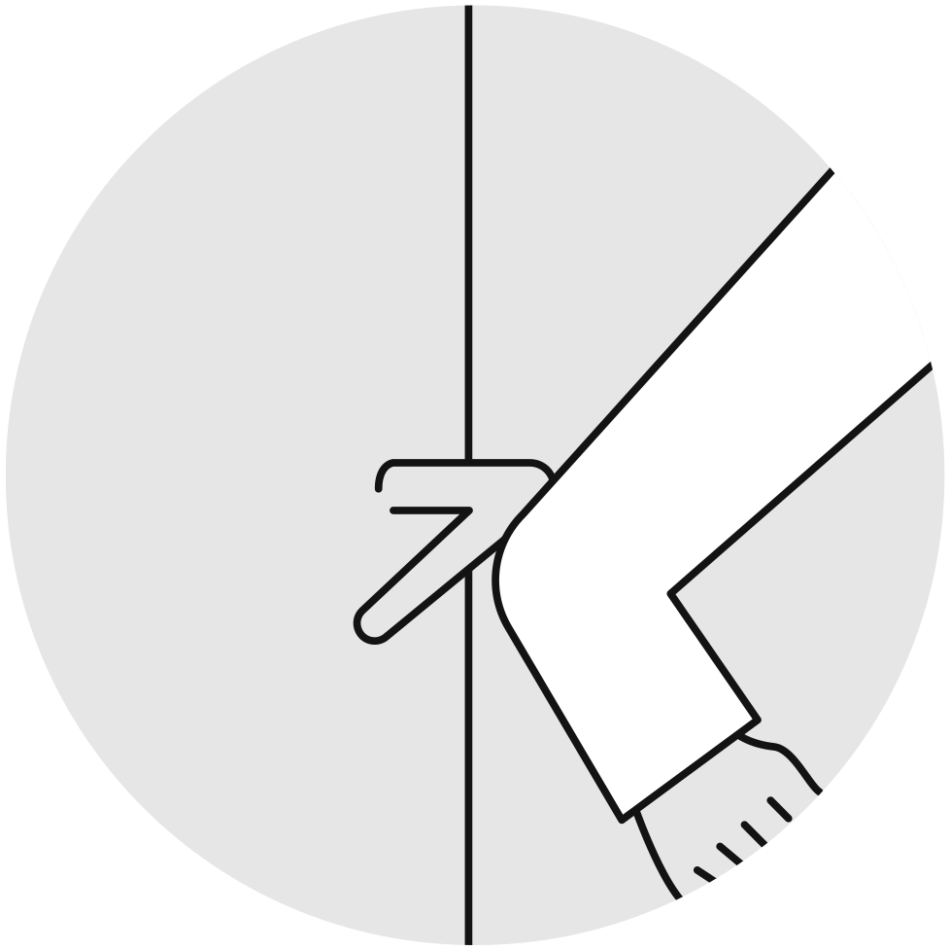
Avoid
getting sick
At your workplace
If possible, use stairs instead of elevators.
Avoid using your hands to touch common objects (door handles, elevator buttons, staircase railings etc.).
It is better to touch objects with a handkerchief or, if necessary, with your elbow.
Always avoid touching your eyes, mouth and nose.
Regularly disinfect your desk and other frequently touched surfaces at your workplace.
p. 24 | October 12, 2020 | Hygiene measures and concepts to prevent COVID-19 infections in textile production facilities

Slide 25


Avoid
getting sick
At your workplace
Find no-contact ways to greet your colleagues (e.g. waving, elbow bumps).
Avoid meal gatherings. If possible, bring your own food box.
For some employees and tasks, it might be possible to work from home or to adopt flexible working hours. Discuss this with your supervisor.
p. 25 | October 12, 2020 | Hygiene measures and concepts to prevent COVID-19 infections in textile production facilities

Slide 26


Avoid
getting sick
Meetings at your workplace
Reduce face-to-face contact with co-workers and maintain at least 1 metre distance between you and others.
If possible, avoid large-scale meetings and use distance-based meetings (e.g. video calls).
Ventilate the workplace regularly.
If possible, keep windows open, at least during meetings.
p. 26 | October 12, 2020 | Hygiene measures and concepts to prevent COVID-19 infections in textile production facilities

Slide 27
If you feel
unwell
Most importantly
Stay at home and do not go to work if you feel unwell or even have mild symptoms of COVID-19 (mild cough or low temperature fever of 37.3°C or more).
Avoid direct contact with anyone.
If you have symptioms, call COVID-19 hotline and follow their advice.
p. 27 | October 12, 2020 | Hygiene measures and concepts to prevent COVID-19 infections in textile production facilities

Slide 28
Getting your workplace ready for COVID-19
Overview of recommended workplace measures. For the management level.

Slide 29
For management
level
At the entrance of the workplace…
Ensure body temperature checks for employees entering the workplace (using infrared thermometer or thermal scanning).
Thermal screening for fever: as per local government guidelines or body temperature above 37.3°C.
p. 29 | October 12, 2020 | Hygiene measures and concepts to prevent COVID-19 infections in textile production facilities

Slide 30
Quizz 5
Do you need to calibrate infrared thermometers for COVID-19 measurements?
Yes
No
Don’t know
p. 30 | October 12, 2020 | Hygiene measures and concepts to prevent COVID-19 infections in textile production facilities

Slide 31
Quizz 5
Answer
Do you need to calibrate infrared thermometers for COVID-19 measurements?
Yes
No
Don’t know
Yes, infrared thermometers used for measuring need to be calibrated.
Measuring distance should be as per manufacturer specification.
Calibration ensures their functionality, accuracy and reliability.
Contact your national Bureaus of Standard for more information.
p. 31 | October 12, 2020 | Hygiene measures and concepts to prevent COVID-19 infections in textile production facilities

Slide 32
For management
level
At the entrance of the workplace…
Make sure that everybody who enters the building cleans their hands and that all personnel have access to places where they can wash their hands with soap and water.
Only allow visitors into the company if absolutely necessary and after screening and risk checks. Visitors should only enter specific work areas.
p. 32 | October 12, 2020 | Hygiene measures and concepts to prevent COVID-19 infections in textile production facilities

Slide 33
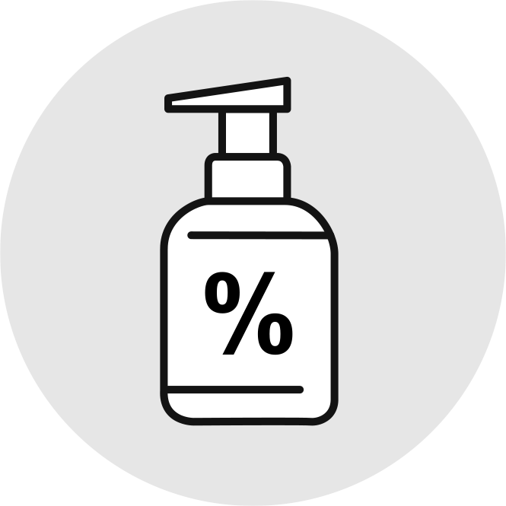
For management
level
Hand sanitisers and wash stations
Put hand sanitiser at the entrance of the workplace and at prominent places around the workplace.
Make sure that hand sanitiser dispensers are regularly refilled.
Establish more hand wash stations throughout the factory with an adequate number of water taps and soap to facilitate frequent hand wash.
p. 33 | October 12, 2020 | Hygiene measures and concepts to prevent COVID-19 infections in textile production facilities

Slide 34

For management
level
Introduce flexible working hours or shifts
Evaluate whether it is possible to introduce flexible working hours or shifts to reduce the number of employees who are in the building at the same time.
If people work together (in the same team or the same shift) and contact is unavoidable, define fixed teams and shift groups wherever possible. This way, you reduce contact between different groups.
p. 34 | October 12, 2020 | Hygiene measures and concepts to prevent COVID-19 infections in textile production facilities

Slide 35

For management
level
Arrange flexible meal hours and spaced seating
Arrange flexible meal hours to avoid crowds in break rooms or places to eat.
Rearrange the dining area to ensure physical distancing. Assign spaced seating.
If possible, use safe outside areas for breaks.
p. 35 | October 12, 2020 | Hygiene measures and concepts to prevent COVID-19 infections in textile production facilities

Slide 36
For management
level
Reduce congestions
Reduce congestion, for example, by having more entry points to the workplace.
Use markings and introduce one-way flows at entry and exit points.
Introduce more one-way flows throughout the buildings.
Regulate use of high traffic areas including corridors, lifts, turnstiles and walkways to maintain physical distancing.
p. 36 | October 12, 2020 | Hygiene measures and concepts to prevent COVID-19 infections in textile production facilities

Slide 37
For management
level
Inbound and outbound goods
Revise pick-up and drop-off collection points, procedures, signage and markings.
Consider methods to reduce frequency of deliveries, for example by ordering larger quantities less often.
Whenever more than one person is required for loading and unloading, the same pair or group of people should be assigned if possible
p. 37 | October 12, 2020 | Hygiene measures and concepts to prevent COVID-19 infections in textile production facilities

Slide 38
For management
level
Review your workflow and layout
Review your company’s layouts, line set-ups or processes to allow people to work further apart from each other.
Use floor tape or paint to mark areas to help workers to keep a distance of at least one metre.
Only where it is not possible to move workstations further apart, allow people to work side by side or facing away from each other rather than face-to-face.
p. 38 | October 12, 2020 | Hygiene measures and concepts to prevent COVID-19 infections in textile production facilities

Slide 39
For management
level
Introduce screens and spaced seating
Where it is not possible to move work stations further apart, install screens / barriers to separate people from one another.
Install screens / barriers for staff at receptions or similar areas.
Tasks that must be performed by two people in close contact to each other, for example lifting, maintenance etc., should always be carried out by the same pairs.
p. 39 | October 12, 2020 | Hygiene measures and concepts to prevent COVID-19 infections in textile production facilities

Slide 40

For management
level
Ventilation system
Ensure that all ventilation systems in your workplace work properly.
Increase total airflow supply to occupied spaces, if possible.
Increase the percentage of outdoor air.
Open windows if possible and safe to do so.
Ensure that exhaust fans in restrooms and kitchens are operating at full capacity.
p. 40 | October 12, 2020 | Hygiene measures and concepts to prevent COVID-19 infections in textile production facilities

Slide 41
For management
level
Ventilation system
Install ultraviolet germicidal irradiation (UVGI) light bulbs / devices in your ventilation systems.
Keep the ventilation systems running at night and during weekends.
Maintain ventilation at normal speed before and after working hours.
p. 41 | October 12, 2020 | Hygiene measures and concepts to prevent COVID-19 infections in textile production facilities

Slide 42
For management
level
Address the specific needs of women
Order personnel protective equipment (face masks, gloves etc.) in different sizes. If sizes are too large, women are not sufficiently protected.
When organising work shifts, consider family responsibilities and make sure that women can get home safely at appropriate times.
Make sure that female workers have access to safe places where they can wash their hands and rest during break times.
p. 42 | October 12, 2020 | Hygiene measures and concepts to prevent COVID-19 infections in textile production facilities

Slide 43

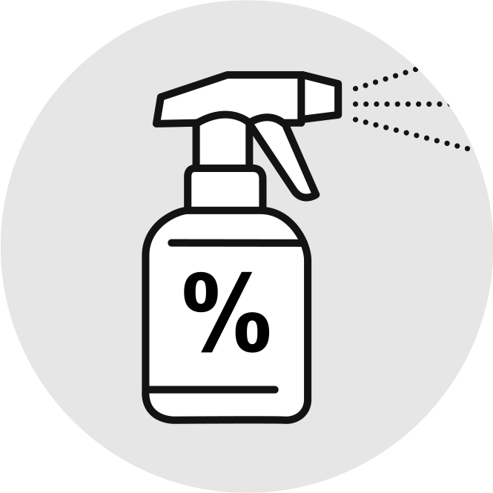
For management
level
The company needs to provide…
Face masks, tissues / wipes and waste bins lined with appropriate plastic bags so that they can be emptied without contacting the content.
For in-house medical staff and cleaning staff, provide personnel protective equipment (gloves, protective suits, masks, goggles).
Provide flu-prevention supplies, such as anti-bacterial soap, hand sanitiser (Alcohol >70%), disinfectants.
p. 43 | October 12, 2020 | Hygiene measures and concepts to prevent COVID-19 infections in textile production facilities

Slide 44

For management
level
Advise to stay home if unwell…
Advise employees to stay at home in isolation or contact a doctor if they show COVID-19 symptoms (fever, cough and shortness of breath).
Assure employees that staying at home in case they feel unwell can be claimed as sick leave.
p. 44 | October 12, 2020 | Hygiene measures and concepts to prevent COVID-19 infections in textile production facilities

Slide 45
Quizz 6
Which of the following topics should be included in COVID-19 trainings and communication with your employees?
Personal hygiene and physical distancing rules within the workplace. Emergency plans and practices. Cleaning programme and monitoring procedures (to relevant staff). Proper use of PPE. Guidance of local authorities and international standards. All the above.
p. 45 | October 12, 2020 | Hygiene measures and concepts to prevent COVID-19 infections in textile production facilities

Slide 46
Quizz 6
Answer
Which of the following topics should be included in COVID-19 trainings and communication with your employees?
Personal hygiene and physical distancing rules within the workplace. Emergency plans and practices. Cleaning programme and monitoring procedures (to relevant staff). Proper use of PPE. Guidance of local authorities and international standards. All the above.
p. 46 | October 12, 2020 | Hygiene measures and concepts to prevent COVID-19 infections in textile production facilities

Slide 47
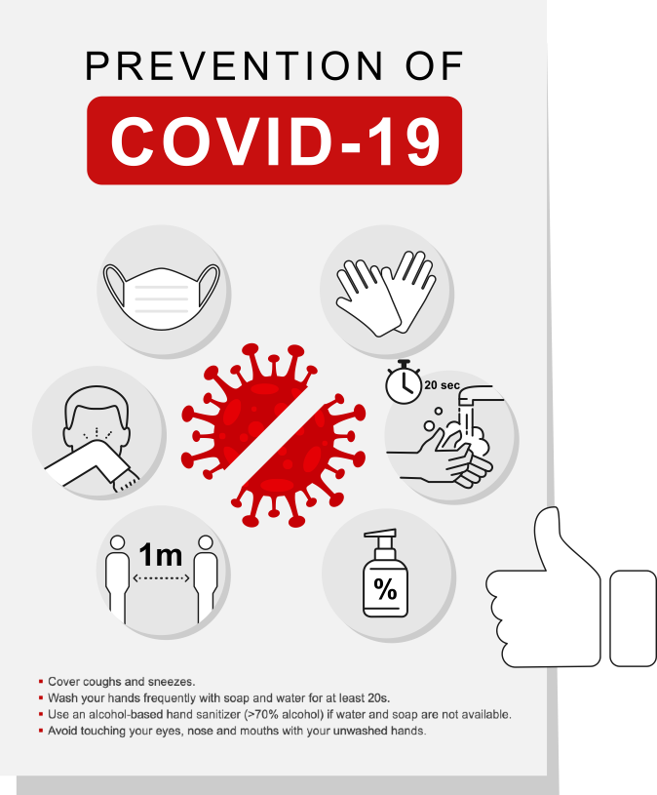
For management
level
Training and communication
Put up posters about COVID-19 measures at the
Entrance
Offices
Kitchens and
Other workplaces.
Encourage and enforce responsible behaviour of the employees.
p. 47 | October 12, 2020 | Hygiene measures and concepts to prevent COVID-19 infections in textile production facilities

Slide 48
For management
level
Posters
Examples of posters can be downloaded from Centers for Disease Control and Prevention CDC):
How to protect yourself and others (CDC) https://www.cdc.gov/coronavirus/2019-ncov/prevent-getting-sick/prevention.html
Stop the spread of germs (CDC) https://www.cdc.gov/coronavirus/2019-ncov/downloads/stop-the-spread-of-germs-11x17-en.pdf
Wash your hands (CDC) https://www.cdc.gov/coronavirus/2019-ncov/downloads/Handwashing-poster-adults.pdf
p. 48 | October 12, 2020 | Hygiene measures and concepts to prevent COVID-19 infections in textile production facilities

Slide 49
For management
level
1
Recommendations for training and communication
Use these communication and training materials as a basis for regular trainings.
Update training materials with regard to new procedures and local guidelines / international standards.
Use simple, clear messaging to explain guidelines by using images, videos and clear language.
Bear in mind that English may not be every employee's first language.
2
3
p. 49 | October 12, 2020 | Hygiene measures and concepts to prevent COVID-19 infections in textile production facilities

Slide 50
For management
level
Recommendations for training and communication
Use virtual training and communication methods to train employees and reduce the need for physical contact.
Short training videos and training messages can be sent to employees via smartphones.
p. 50 | October 12, 2020 | Hygiene measures and concepts to prevent COVID-19 infections in textile production facilities

Slide 51
For management
level
COVID-19 emergency plan
Develop an emergency plan in case a suspected COVID-19 case occurs at your workplace (cough, shortness of breath, fever).
Identify a room where the sick person can be safely isolated.
Include contact data of the official local COVID-19 hotline.
Identify a safe way to transfer the sick person from the workplace to the recommended health facility.
p. 51 | October 12, 2020 | Hygiene measures and concepts to prevent COVID-19 infections in textile production facilities

Slide 52
For management
level
COVID-19 emergency plan
Describe how to identify emergency contacts of the sick employee.
Include contact data of relevant local authorities to inform them about confirmed cases.
Describe the comprehensive cleaning and disinfection programme (seek local guidance).
Agree to the emergency plan in advance with your partner health care provider or health department.
Assign responsibilities to monitor and control infection.
p. 52 | October 12, 2020 | Hygiene measures and concepts to prevent COVID-19 infections in textile production facilities

Slide 53
Quizz 7
COVID-19 waste: can it be disposed together with general waste?
Yes
No
Don’t know
p. 53 | October 12, 2020 | Hygiene measures and concepts to prevent COVID-19 infections in textile production facilities

Slide 54
Quizz 7
Answer
COVID-19 waste: can it be disposed together with general waste?
Yes
No
Don’t know
No, waste that has come into contact with a sick person should be put into a specially marked bag and be tied up.
The bags should be put in a safe place and marked as infectious waste for appropriate treatment and disposal.
They should never be disposed together with general waste. Local health authorities can provide information about correct disposal.
p. 54 | October 12, 2020 | Hygiene measures and concepts to prevent COVID-19 infections in textile production facilities

Slide 55
For management
level
Workplace risk assessment
Develop a workplace risk assessment plan.
The risk of work related exposure to COVID-19 depends on the probability of coming in close (less than 1 metre) or frequent contact with people who may be infected and through contact with contaminated surfaces and objects.
Keep records of all workers and visitors.
Assess hazard and risk factors resulting from your specific work environment and working conditions.
p. 55 | October 12, 2020 | Hygiene measures and concepts to prevent COVID-19 infections in textile production facilities

Slide 56
For management
level
Workplace risk assessment
Try to eliminate identified risks (e.g. through barriers and more distance between desks, unidirectional personnel flow etc. – see previous slides).
If the hazards cannot be eliminated completely, their significance to the health and safety of workers (magnitude of the risk) should be assessed and measures should be taken to reduce risks to a manageable level.
Consult with your local authorities for advice if needed.
p. 56 | October 12, 2020 | Hygiene measures and concepts to prevent COVID-19 infections in textile production facilities

Slide 57
For management
level
Remember
The new normal will not be the same for every factory.
p. 57 | October 12, 2020 | Hygiene measures and concepts to prevent COVID-19 infections in textile production facilities

Slide 58
Hygiene
concept: definitions
Overview and explanation of important terms in hygiene concepts. For management and personnel involved in cleaning.

Slide 59
For management and personnel involved in cleaning
Hygiene concept: definitions
Cleaning: Using soap and water removes germs in form of dirt, dust, visible debris and food particles. Soap and hot water kill some type of bacteria and viruses.
Sanitising: Using a sanitiser product reduces microbiological contamination. Sanitisers kill most bacteria.
Disinfecting: Disinfecting kills germs. Using a disinfectant can destroy bacteria, viruses and fungi (except their spores).
p. 59 | October 12, 2020 | Hygiene measures and concepts to prevent COVID-19 infections in textile production facilities

Slide 60

For management and personnel involved in cleaning
Hygiene concept: routine
Ensure frequent deep cleaning of the entire workplace and ensure that surfaces are clean and hygienic.
Cleaning should always start from the cleanest to the dirtiest area to not spread the dirt to areas that are less soiled.
Clean the workplace and surfaces using soap or a neutral detergent, water and mechanical action (brushing, scrubbing) to remove dirt, debris and other materials.
Disinfect surfaces to inactivate (i.e. kill) pathogens and other microorganisms.
p. 60 | October 12, 2020 | Hygiene measures and concepts to prevent COVID-19 infections in textile production facilities

Slide 61
For management and personnel involved in cleaning
Hygiene concept: cleaning plan
Develop cleaning plans stating responsibilities, times and signatures and monitor compliance. See example below:
Area /Item | Frequency | Procedure | Cleaning Agents | Person Responsible | Time | Signature
p. 61 | October 12, 2020 | Hygiene measures and concepts to prevent COVID-19 infections in textile production facilities

Slide 62
For management and personnel involved in cleaning
Hygiene concept: areas
Identify high-risk areas for regular cleaning and disinfection such as:
Restrooms
Locker rooms
Training rooms
Kitchen and coffee rooms
Water fountains and refill stations
Conference rooms
Workplace health units
p. 62 | October 12, 2020 | Hygiene measures and concepts to prevent COVID-19 infections in textile production facilities

Slide 63
For management and personnel involved in cleaning
Hygiene concept: surfaces
Identify high-touch surfaces for priority disinfection and wipe them with disinfectant regularly. These surfaces include:
Desks and tables
Door and window handles
Light switches
Bathroom surfaces
Computer keyboards
Phones and other work surfaces
p. 63 | October 12, 2020 | Hygiene measures and concepts to prevent COVID-19 infections in textile production facilities

Slide 64
For management and personnel involved in cleaning
Hygiene concept: disinfection
Disinfectant solutions must always be prepared and used according to the manufacturer’s instructions.
Ensure that disinfection workers are familiar with the instructions.
Ensure the use of PPE.
Avoid mixing different chemical disinfectants.
Rooms should only be disinfected if there are no employees inside. Ensure that all doors and windows are closed.
p. 64 | October 12, 2020 | Hygiene measures and concepts to prevent COVID-19 infections in textile production facilities

Slide 65
For management and personnel involved in cleaning
Hygiene concept: products to be used
In non-health care settings / workspaces
Disinfectant – workspaces: sodium hypochlorite (bleach / chlorine) at a concentration of 0.1% or 1,000ppm (1 part of 5% concentrated household bleach to 49 parts of water)
Sanitisers – hand: Alcohol (>70%)
Surfaces sensitive to bleach: Alcohol (>70%), Chloroxylenol (4.5 to 5.5%), Benzalkonium Chloride
Surfaces must be cleaned with water and soap or a detergent first to remove dirt, followed by disinfection.
p. 65 | October 12, 2020 | Hygiene measures and concepts to prevent COVID-19 infections in textile production facilities

Slide 66
For management and personnel involved in cleaning
Hygiene concept: handling of desinfectants
Disinfectant solutions should be stored in opaque containers in a well-ventilated area that is not exposed to direct sunlight.
Disinfectant solutions should be freshly prepared every day.
Disinfectants should be applied with a cloth or wipe which is soaked in disinfectant.
Make sure to wear required personnel protective equipment (gloves, goggles, mask, protective suit).
Cover the bucket with a lid and label it.
p. 66 | October 12, 2020 | Hygiene measures and concepts to prevent COVID-19 infections in textile production facilities

Slide 67
Quizz 8
Is it recommended to spray your workers with disinfectants before they enter the workplace (e.g. in a tunnel, cabinet or chamber)?
Yes
No
Don’t know
p. 67 | October 12, 2020 | Hygiene measures and concepts to prevent COVID-19 infections in textile production facilities

Slide 68
Quizz 8
Answer
Is it recommended to spray your workers with disinfectants before they enter the workplace (e.g. in a tunnel, cabinet or chamber)?
Yes
No
Don’t know
Spraying individuals with disinfectants (e.g. in a tunnel, cabinet or chamber) is not recommended under any circumstances.
This could be physically and psychologically harmful and does not stop an infected person to spread the virus through droplets or contact.
p. 68 | October 12, 2020 | Hygiene measures and concepts to prevent COVID-19 infections in textile production facilities

Slide 69
Facilitator’s tasks; resourses and guidance
Conveying information and moderating action.
References and links to further information.

Slide 70
Facilitator’s
tasks
Adapt training materials to the country-specific context and language, if required.
Add best practices from the local context (examples, pictures, videos, quizzes). This makes the course more interesting and interactive.
Do not include more than 30 participants in a course to allow discussions and exchange. For example, take two participants each from 15 companies.
Ideally, there should be a workforce representative among the participants from the companies. This person should be particularly interested in the training content on women's specific needs, flexible working hours and sick leave.
p. 70 | October 12, 2020 | Hygiene measures and concepts to prevent COVID-19 infections in textile production facilities

Slide 71
Facilitator’s
tasks
Conduct the training course in an interactive way (invite participants to actively participate in discussions, quizzes, question and answer sessions).
The question and answer session should be approximately ¼ of the time allocated to the training course.
Facilitate the discussion process by asking specific guiding questions.
Assess if the participants achieve the objectives of the exercises.
Include health breaks.
Have the participants sign signature lists at the end of the training.
Check the understanding of the training contents with a test at the end of the training.
If possible, issue a training certificate after successful course completion. This increases the visibility and value of the training.
p. 71 | October 12, 2020 | Hygiene measures and concepts to prevent COVID-19 infections in textile production facilities

Slide 72
Resources
and guidance
WHO COVID-19 https://www.who.int/emergencies/diseases/novel-coronavirus-2019
WHO – Getting your workplace ready https://www.who.int/docs/default-source/coronaviruse/getting-workplace-ready-for-covid-19.pdf
CDC Guidance for businesses https://www.cdc.gov/coronavirus/2019-ncov/community/guidance-business-response.html
OSHA guidance – Guidance on preparing workplaces for COVID-19 https://www.osha.gov/Publications/OSHA3990.pdf
ILO - COVID-19 business resilience guides for garment factories in Asia https://www.ilo.org/asia/publications/issue-briefs/WCMS_748040/lang--en/index.htm
Gov. UK– Working safely during coronavirus (COVID-19) https://www.gov.uk/guidance/working-safely-during-coronavirus-covid-19/factories-plants-and-warehouses
p. 72 | October 12, 2020 | Hygiene measures and concepts to prevent COVID-19 infections in textile production facilities

Slide 73
Thank you!
Stay safe
and healthy.

